Slide 1



Paper ID 01
Cognitive Load Classification during Arithmetic Task using Single Convolution Layer based 2D-CNN Model
Authors Names
Name of the Department
Name of Institute, City, State
4th International Conference on Machine Vision and Augmented Intelligence MAI-2024 (Hybrid Mode) 20th – 22nd December 2024 | MANIT Bhopal, India

Slide 2
Presentation Outline
Introduction
Dataset Description
CNN Architecture
Performance Measures
Results and Analysis
Conclusion and Future Scope
References

Slide 3
Introduction
Cognitive load (CL) also called Mental Workload (MWL) is the quantitative measure of mental effort required to complete a task [1].
It is used in many fields like driver health assessment, educational program review, mental state analysis of airplane dispatchers and pilots [2].
An optimal CL is required for better performance and if it exceeds a certain limit it can cause mental fatigue. Mental fatigue causes loss in employee performance and for finding an optimal CL some assessment or measure for CL is required.
Cognitive Load can be measured using various methods [3] like traditional manual questionnaire process, physiological signals like electroencephalogram (EEG) [4], electrocardiogram (ECG), galvanic responses [5], and eye movement tracking [6].

Slide 4
Introduction Cont.
EEG signals are used to measure the activity of the brain due to change in electrical voltage because of synaptic excitations of dendrites. EEG signals are classified into 5 categories based on their frequency band.
CL can be measure through EEG and it is also the cheapest way. But EEG has some limitations of its own as it easily gets affected by artifacts/ noises. These artifacts can be removed from the signal using various signal processing and filtering methods [8-10].
Many studies have been done for MWL assessment using EEG signals. CL assessment is used for evaluating multimedia resources for education [11]. It is highly beneficial especially in the time of pandemic when the mental health is of utmost importance.

Slide 5
Introduction Cont.
MWL assessment is very importance for society and it is also related to almost all the tasks which engages brain [14-15] like emotion detection [16-17], mental stress identification [18-19]
At present the recent trend of research is the use of CNN and other deep learning models to solve classification problems. Therefore, in this paper an attempt has been done to classify mental state of subject based on their CL while performing mental arithmetic task.
Novelty of this paper is that, for the first time 2D-CNN model is utilized on the EEG dataset of mental arithmetic calculations. For this one dimensional EEG signal is reshaped into two dimensional matrix as input to 2D-CNN. EEG dataset which has data for mental arithmetic task is used [7].

Slide 6
Dataset Description
The dataset comprises 36 recording of multichannel EEG corresponding to 36 subjects at the time of mental arithmetic task. Out of 36 subjects, 26 are Good Counter and 10 are Bad Counter.
The EEG signal is recorded with the help of a device named Neurocom Monopolar EEG 23-channel system.
The EEG signals are recorded for 61 seconds with a sampling frequency of 500 Hz
The shape of the matrix for a single subject is 19*31000. The shape of the matrix is reshaped. The new shape of the matrix is 760*775 where each channel’s signal is divided into 40 equal parts and arranged consecutively to form the new shape. This is done to make shape of the matrix symmetric

Slide 7
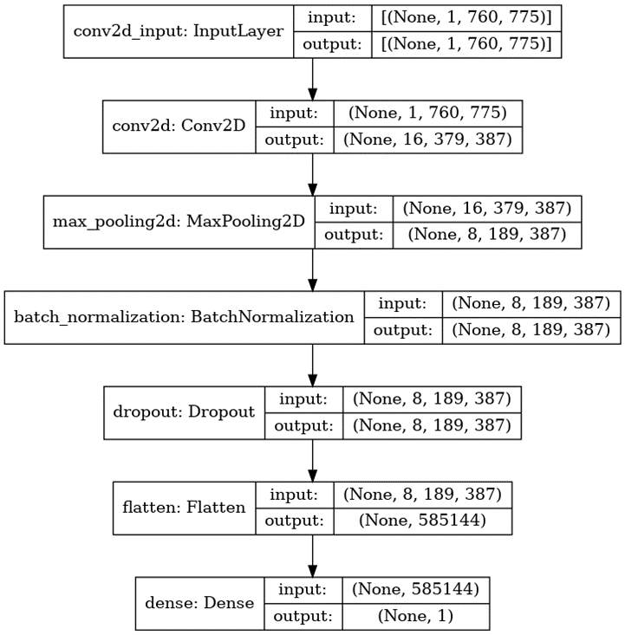
CNN Architecture
Fig. 1. The Architecture of the CNN used for Classification

Slide 8
Performance Measures
(iii) Recall (RC) or Sensitivity:
RC = TP / (FN + TP), (3)
(iv) F1 Score:
F1 = 2 * ((PR * RC) / (PR + RC)), (4)

Slide 9
Performance Measures
There are different performance measures used to compare the different architectures of CNN, such as Accuracy, Precision, Recall, Area Under Curve, and F1-score.
(i) Accuracy (ACC):
ACC = (TP + TN) / (TP + TN + FP + FN), (1)
(ii) Precision (PR)/ (Positive Predictive Value (PPV)):
TPR = TP / (TP + FP), (2)

Slide 10
Results and Analysis
Table 1. Performance Measures for numbers of filters 32 in the architecture
Stride Size | Accuracy | Precision | Recall | AUC | F1-score
1 | 94.44% | 96.15% | 96.15% | 93.07% | 96.15%
2 | 88.88% | 100.00% | 84.61% | 92.30% | 91.66%
3 | 86.11% | 95.65% | 84.61% | 88.84% | 89.79%
4 | 94.44% | 92.85% | 100.00% | 94.61% | 96.29%

Slide 11
Results and Analysis
Table 2. Performance Measures for numbers of filters 16 in the architecture
Stride Size | Accuracy | Precision | Recall | AUC | F1-score
1 | 94.44% | 96.15% | 96.15% | 93.07% | 96.15%
2 | 97.22% | 96.29% | 100.00% | 94.80% | 98.11%
3 | 88.88% | 100.00% | 84.61% | 91.53% | 91.66%
4 | 94.44% | 96.15% | 96.15% | 92.88% | 96.15%

Slide 12
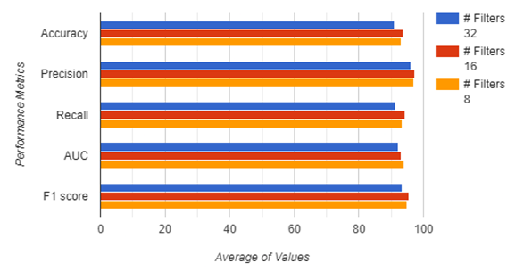
Results and Analysis
Fig. 2. Average Performance Measures for different numbers of filters

Slide 13
Conclusion and Future Scope
In this study, a single convolution layer based 2D-CNN architecture is used to classify total 36 subjects into Good counter and Bad counter based on the EEG signals recorded during mental task.
The various parameters of CNN like no. of filters, kernel size, and stride length are varied to find the optimum architecture which gives the best performance.
The best accuracy of 97.22% is achieved for kernel size 3, no. of filters 16, and stride size 2 when using hold-out validation. The same architecture when used with leave-one-subject-out validation gives accuracy of 94.44%.
In future this work will be extended using data augmentation techniques for generating new data samples in order to make number of samples balanced in both the classes.

Slide 14
References
1. Gevins, A., 1997. High-resolution EEG mapping of cortical activation related to working memory: effects of task difficulty, type of processing, and practice. Cerebral Cortex, 7(4), pp.374-385.
2. Plechawska-Wójcik, M., Tokovarov, M., Kaczorowska, M. and Zapała, D., 2019. A ThreeClass Classification of Cognitive Workload Based on EEG Spectral Data. Applied Sciences, 9(24), p.5340.
3. Paas, F., Tuovinen, J., Tabbers, H., & Van Gerven, P. W. M., 2003, Cognitive load measurement as a means to advance cognitive load theory. Educational Psychologist, 38, 63– 72.
4. Antonenko, P., Paas, F., Grabner, R. et al., 2010, Using Electroencephalography to Measure Cognitive Load. EducPsychol Rev 22, 425–438.
5. D. Hossain et al.,2019, Cognitive Load Measurement Using Galvanic Skin Response for Listening Tasks, 2019 4th International Conference on Electrical Information and Communication Technology (EICT), Khulna, Bangladesh, pp. 1-4.

